Slide 1
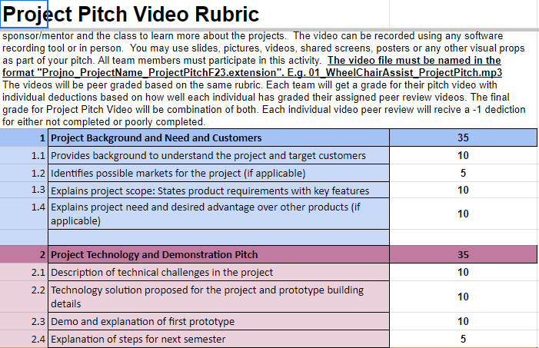
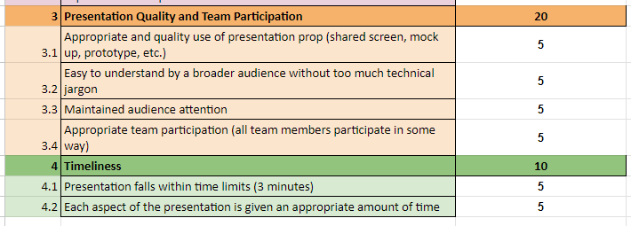
-3 minute (180 seconds) max video
-keep low amount of text on slides
-write talking points in speaker notes or google doc if needed
-abt 20 seconds per slide?

Slide 2
Project Pitch Video
Residential Power Disagreggation - Team 50
Team Members
Andrew Bailey, Ralph Cullom, Manny Harris, Labib Kasim
Mentor - Sponsor
Huangjie Gong - ABB
Notes:
Manny (5 sec)

Slide 3
Scope
Requirements/Features:
Disaggregate (split up) the total residential load
Data must wirelessly accessible
Weather data incorporated into predictions
What makes us different?
Our project will differ from competitors by offering a low cost solution
Notes:
- Labib
- our aim is to build a cost effective device that can be attached in residential households that dissagregates energy information and include that information with real time weather data based on which the user can make successful predictions

Slide 4
Technical Challenges & Our Solution
What is our project’s device?
A device that disaggregates the load used in a residential home
How does it work?
By recording data and processing it through machine learning algorithms, all while displaying it on a separate website
Challenges
Connecting ESP32 to database to store measurements
Machine learning model accuracy
Notes:
- Manny
- Our project is creating an internet connected system for consumers to measure their total power usage and split it into individual measurements of each appliance or load.
- This solution will incorporate machine learning and data processing to forecast the residential load across different categories based on the total measurement the display them
Challenges
-ESP32
-Some machine learning algorithms predict energy consumption better than others

Slide 5
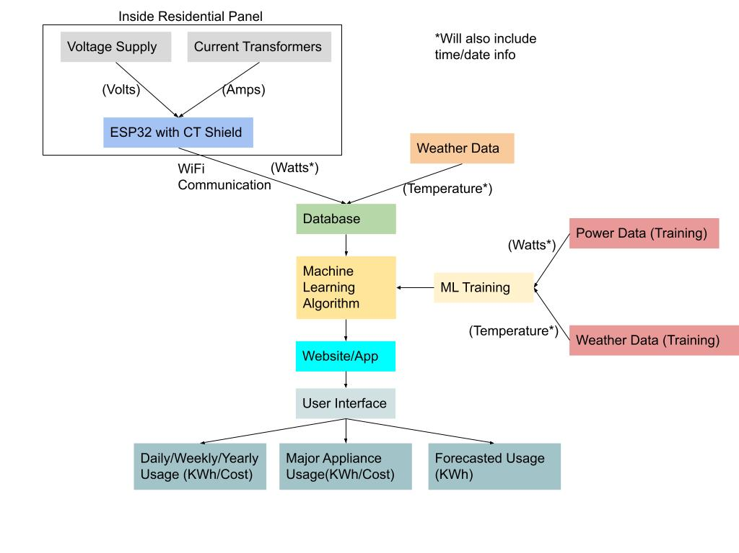
Project Breakdown
Notes:
Andrew
Device measures lumped power usage of a household from the residential panel and sends it to a database where weather data is added
A machine learning will take the total usage data and weather as inputs, then output the individual load use predictions to be displayed to the user

Slide 6
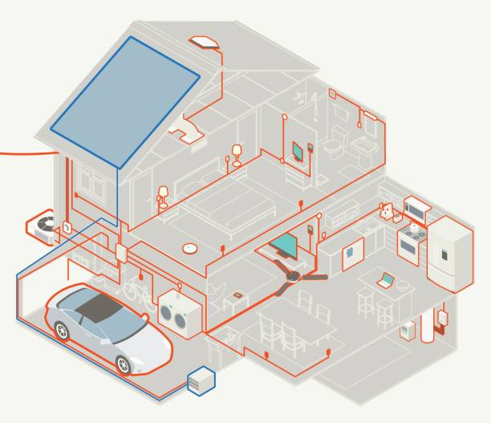
Consumer Base
Why measure home energy usage?
Efficiency
Cost
https://www.istockphoto.com/vector/house-electrical-diagram-gm641554546-116141169
Notes:
Ralph
Our project is for nearly every residential home in the U.S.
Why measure home energy usage?
Measure how much energy different appliances use allows homeowners to save money
Users can know what their energy bill is funding, and high usage appliances that could be upgraded to reduce it
Our project offers consumers a cost effective, non invasive way to measure their energy usage

Slide 7
Project
Demo
Notes:
-Manny

Slide 8
Subsystems
Data Handling
Machine Learning
Power Measurement
Graphical User Interface
Notes:
-Manny
-Mention different subsystems

Slide 9
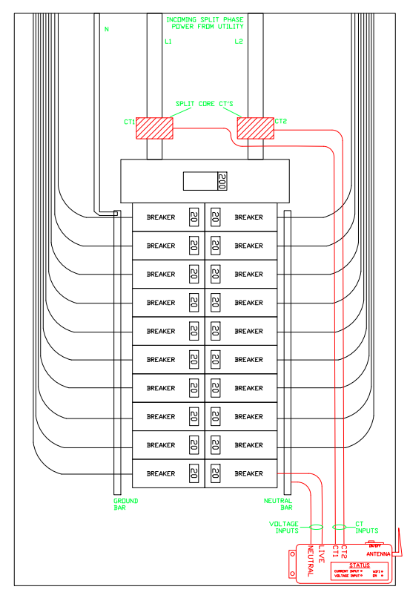
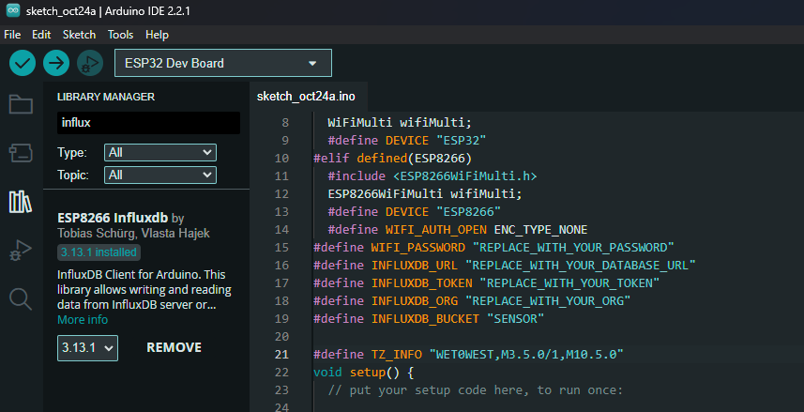
Power Measurement Subsystem
Notes:
The picture on the right is the final design for our product. You can see the two current transforms at the input of the panel. We need a way to send this measured data to a database. We are using Arduino IDE to send code to ESP32 device. The ESP32 sends the data using wifi to a cloud database. Right now we have the ESP32 measuring and sending over wifi signal strength data. Our next step is top get the ESP32 to read and send over the data the current transformers are measuring in real time

Slide 10
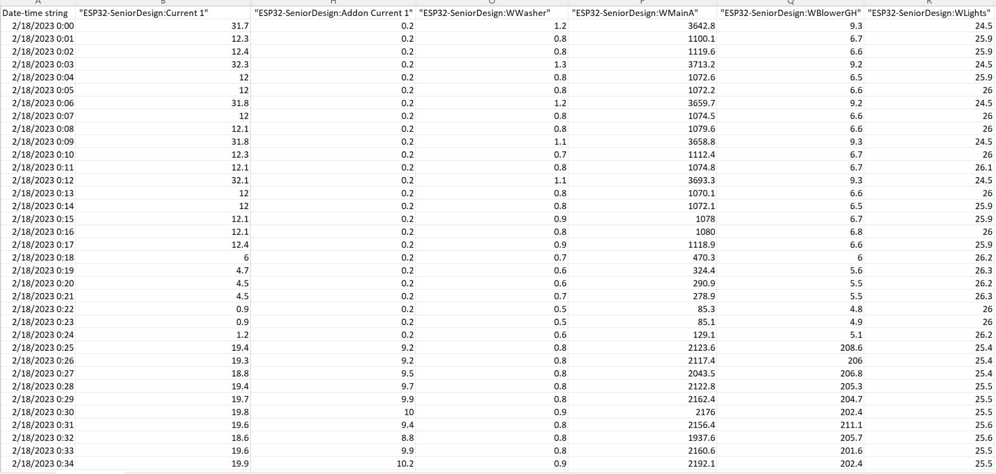
Data Handling Subsystem
Receive the data through influx db
Remove noise and other irrelevant info from the data
Add a column for weather details
Send revised data to ML model
Notes:
-excel snippet -> this is an example of data that we recieve from our device.
-gives every single appliance information as well as current, so we would ideally want to get rid of that
-what I am working on -> is using a python pre processing tool ->combining everything to get the total power information for each specific day,
-and another thing that I am trying to add another column to include the weather information on each particular day-> I would be doing this by adding a weather api -> includes real time weather data and find a way to combine that with the data -> and send this pre-proccessed data to the machine learning model

Slide 11
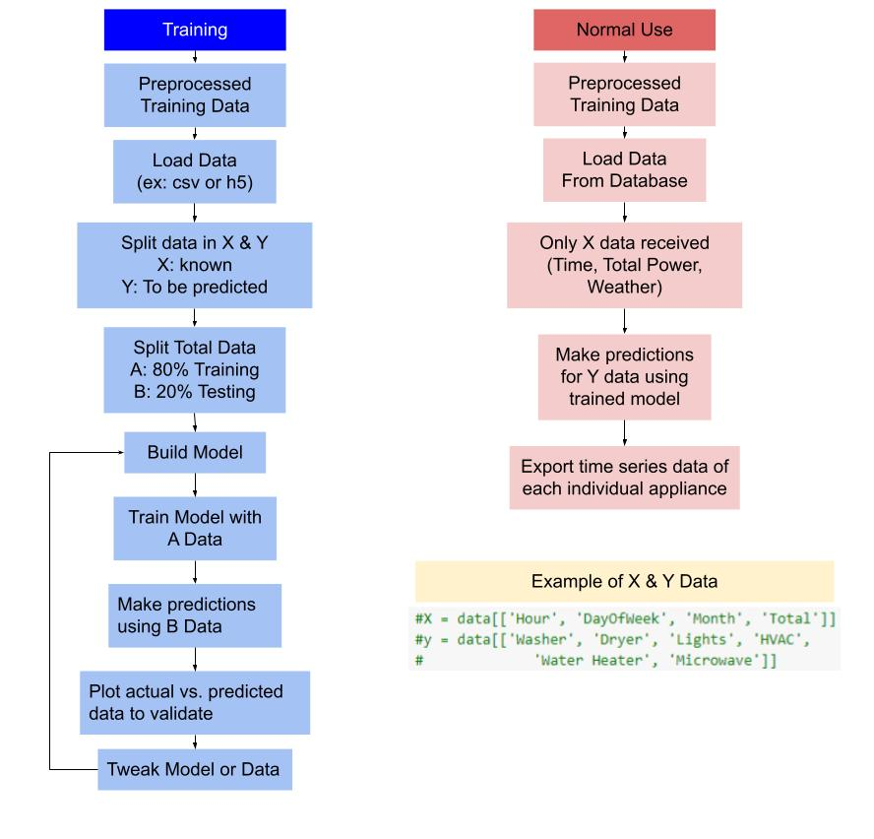
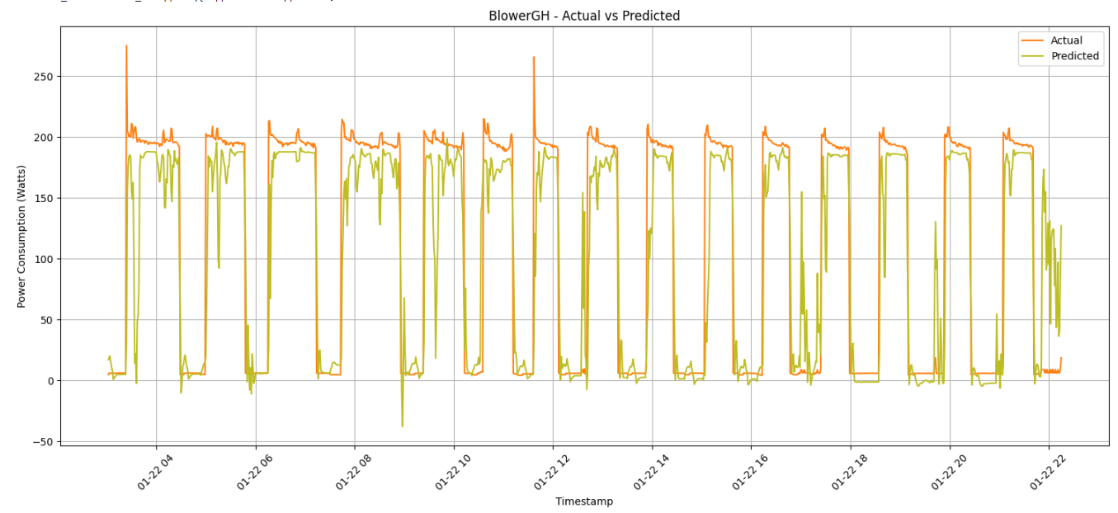
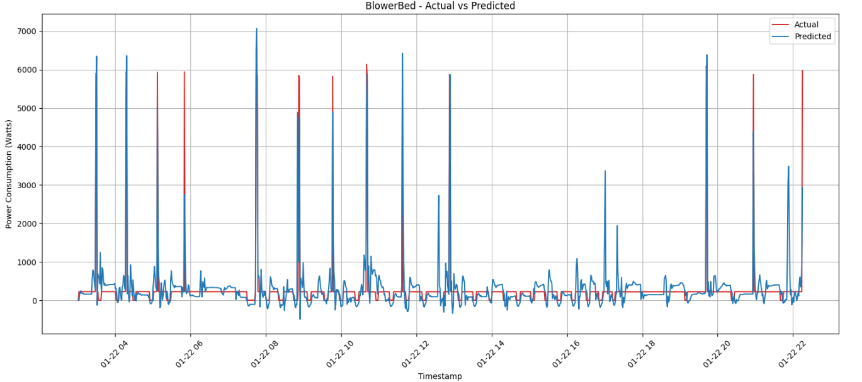
Machine Learning Subsystem
Model Creation
Model Output
Notes:
- Andrew
- as seen on the left, the machine learning model is created with training data that has information on total power usage and individual appliance usage
- the algorithm finds different patterns and relations in the data and votes on which ones are best for making predictions
- looking to the right, the model was given only the total power usage data on and then it outputs its predictions which can be verified against what we measured for testing

Slide 12
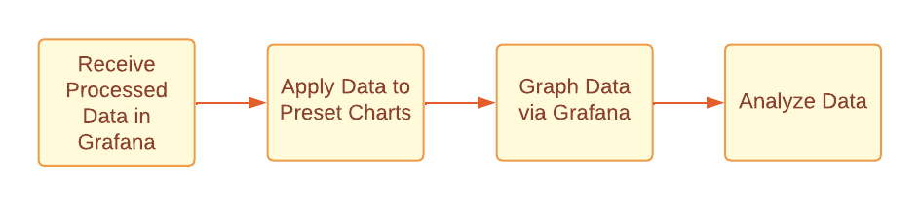
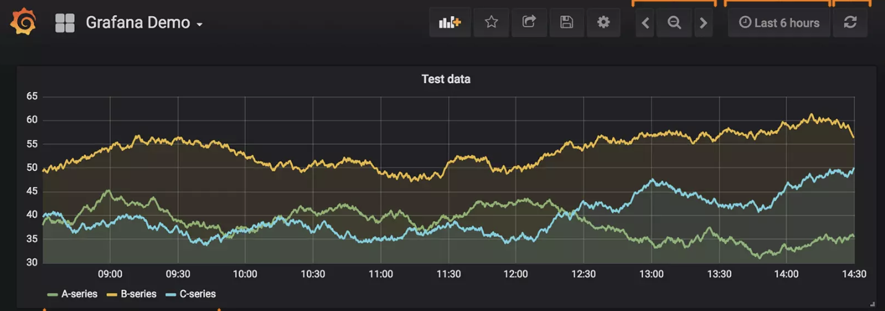
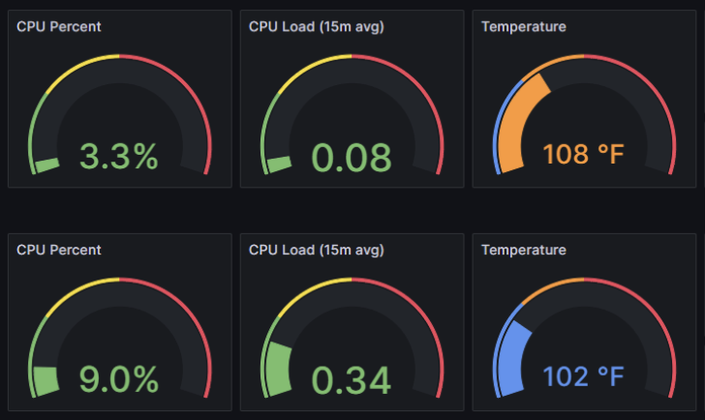
Graphical UI Subsystem
Notes:
-Ralph

Slide 13
Next Steps
Notes:
-Ralph

Slide 14
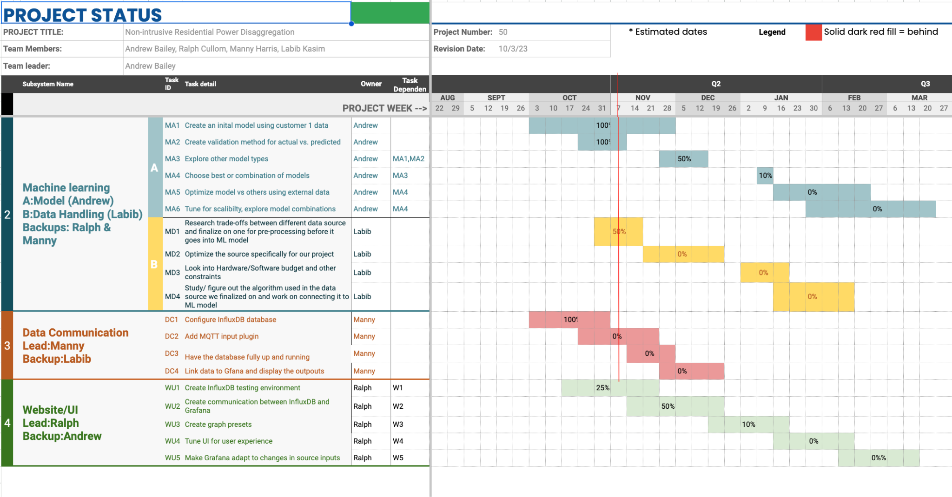
Steps for Next Semester
Notes:
-Ralph
Maximize use of recorded data
Improve ML algorithm
Improve device reliability
Improve website UI for user experience

Slide 15
Thanks for Watching

